Slide 1
Regulatory Pressure – A Vendor’s Viewpoint
Mike Hourigan
Sr. Director Regulatory Strategy, Cerner Corporation

Slide 2
Cerner’s Approach

Slide 3
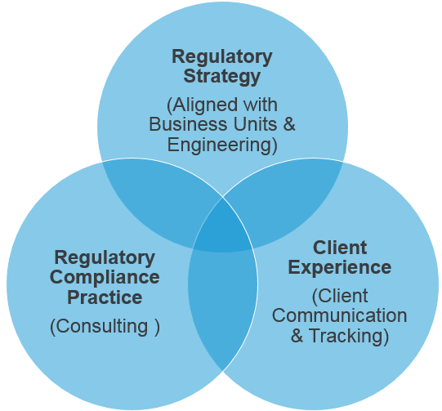
Structure and coverage
Current Key Topics
Payment System Rules
  IPPS, OPPS, FFS, SNF, IRF, IPH, HHA/HOSP, LAB, LTCH
    Payment system, Conditions of Participation, Quality Measures
Meaningful Use
  Certification/Surveillance
MACRA QPP
CPC+
CJR/EPMS
General Data Protection Regulation (EU)
21st Century Cures
CMMI Model Programs
Many other regulatory rules/programs/topics

Slide 4
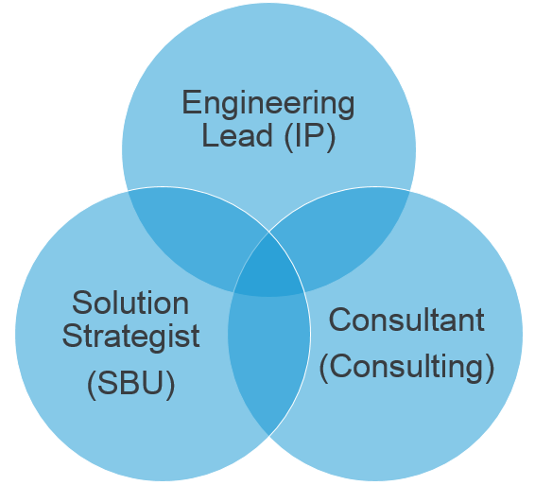
2015 Edition CEHRT & Meaningful Use Stage 3
Meaningful Use Approach
“Triad” aligned at the certification criteria level
  Responsible for overall design to ensure objectives/measures met through optimal workflow
Started development based on NPRM
Client Design Partners/Solution Partners
Participation with ONC in focused Kaizens
Partnered with ICSA to review test methods
Current Status
Code GA in January 2017
Active with testing efforts
Clients upgrading/implementing
  Slower adoption than anticipated

Slide 5
Challenges
New required criteria
  API to support consumer access
    Hasn’t been widely adopted by the healthcare industry
    Need wiring in place, but very few consumer apps in the market
    Some clients use 3rd party portals with Identity Providers that may not be able to connect to the API
  Unique Device Identifier (UDI)
    Challenge for clients using 3rd party surgery systems
    Confusion related to clinical vs inventory use of UDI
    May require the purchase scanners for optimal workflows
  Immunizations
    State/jurisdictions Immunization Registries may not be ready to accept NDC or not ready for bidirectional
Impact to other development
  Has not caused us not to do other strategic development, but has an effect of continual and refined requirements that makes you feel as though you are never done
    Continual interpretative points and conformance testing requirements emerge that require development
    Examples:
      Auditing naming conventions – ONC/ISCA question event naming for security privilege changes, and whether they should be “verb/noun” or “verb” only
      Review of test method and conformance testing for CDA uncovered the need to have Administrative Sex in the CCD header

Slide 6

Programs that require the use of CEHRT
CEHRT
Meaningful Use
Alternative Payment Models (APMs)
  Comprehensive Primary Care Plus (CPC+)*
  Medicare Shared Savings Program - Tracks 1, 2*, and 3*
  Next Generation ACO Model*
  Comprehensive ESRD Care (CEC) (LDO arrangement)*
  Oncology Care Model (OCM) one-sided risk arrangement
  Oncology Care Model (OCM) two-sided risk arrangement*
Merit-Based Incentive Payment System (MIPS)
  Advancing Care Improvement (ACI)
  Quality Category**
Chronic Condition Management (CCM)
Inpatient Quality Reporting (IQR)
Mandatory Episode Based Payment Models (EPMs)***
  Comprehensive Care for Joint Replacement (CJR)
  Acute Myocardial Infarction (AMI)
  Coronary Artery Bypass Graft (CABG)
  Surgical Hip/Femur Fracture Treatments (SHFFT)
Certified Community Behavioral Health Centers (CCBHCs) Pilot Program
State Programs
  Public Hospital Redesign & Incentives in Medi-Cal Program California (PRIME)
**Only if using EHR data submission method
*Advanced APM’s
***Only if using as an Advanced APM for QPP
Notes:
Stark and Anti-kickback for a new donation
CCBHC – Cert as of the vesion that you start you reporting period. July 2017, so would work, and think that you can stay on that version for the life of the program (2 years). If you change vendors, then would need to be on the latest version (Ashley will know states. Missouri is one of them)
PRIME – Referenced as a participation for state-owned owned.
1/1/18 – Outside of MU and non-ACO participant in MIPS, we don’t know of any regulatory relief or remedy for not being on 2015 CEHRT for any of the other program. No hardship. Presume that you will be kicked out of the ACO, CPC+.

Slide 7
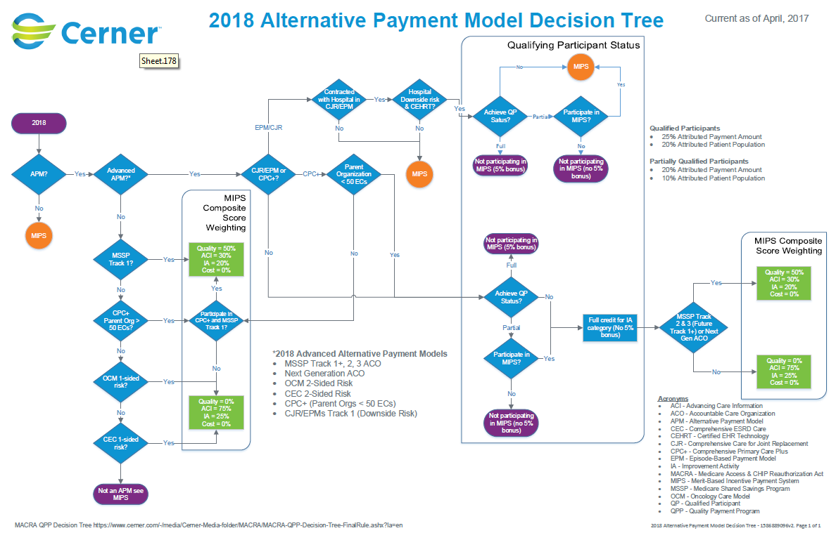

Slide 8
Client Impact

Slide 9
Impact to clients
We have seen a lack of client urgency for Stage 3 Meaningful Use
  Many clients were anticipating the delay that was just included in the IPPS NPRM
    90 day reporting period for MU3 for EH/CAH and EPs (for Medicaid) in 2018
    Already a 90 day reporting period for the ACI domain for ECs in MIPS
    Caution: eCQM Reporting
      For EHs/CAHs participating in IQR – report data for first three quarters of 2018 using 2015 Edition CEHRT
      For ECs participating in Medicaid MU Stage 3 – full year of reporting of eCQMs to align with MACRA QPP/MIPS Quality Domain
    Some decided to wait-and-see with new administration
    Some have dropped out of the program (mostly Medicaid EHs and EPs since no penalties)
Client Challenges
  Rate of change with Meaningful Use, MACRA, CJR/EPM and other programs
  Upgrades and implementation of new workflows to support MU/ACI objective/measures
  Financial impact of programs and work effort to implement required solutions (is it worth it?)
  Keeping up with regulations and which programs they are impacting

Slide 10
Cerner Support
Regulatory Alignment Summits
  5 events in 2017
  2 day event with MU, Quality, MACRA QPP, APMs, EMPs sessions
  Day 2 includes individual planning sessions which each client organization
Client Regulatory Council
Monthly webinars on regulatory topics
Surveys to assist clients with planning and to understand their challenges
Internal social media platform used to share information with clients and allow them to ask questions of Cerner and their peers
Wiki Guides
  Regulatory
  Meaningful Use
  CPC+
  MACRA QPP

Slide 11
What’s Next?
21st Century Cures Act
  Information blocking – for HIE’s, HIT Vendors & Providers
  Reducing regulatory burden
  EHR reporting program – “Consumers Digest” for EHR’s
  Creation of the a Pediatric certification
Potential for hospitals to move to a MIPS like program
Changes coming for LTPAC – quality programs, data standardization, potential participation in APMs
Continued push for Interoperability and use of consumer API’s
Appropriate Use Criteria (AUC) for Advanced Diagnostics
Expanded use of CEHRT to other programs
Uncertainty for what comes after Meaningful Use Stage 3

Slide 12
Current State of Regulatory Payment Impact

Slide 13
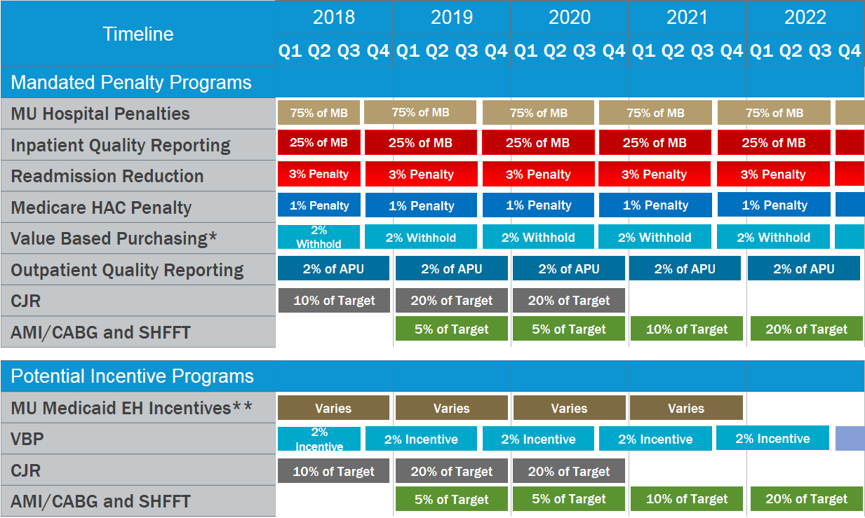
High Level Regulatory EH Payment Impact
*Only applies if Hospital is not already being penalized under IQR
**Must start in 2016 or earlier
Notes:
MB = Market Basket
APU = Annual Payment Update
CJR = Comprehensive Care for Joint Replacement
IQR = Inpatient Quality Reporting

Slide 14
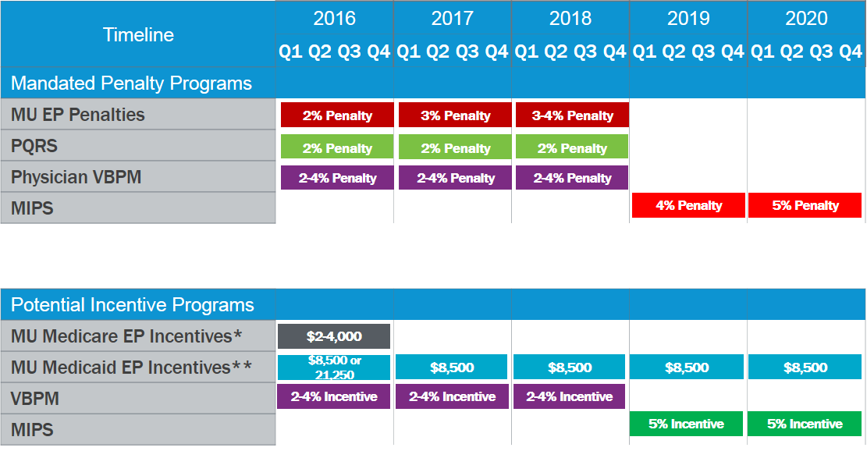
High Level Regulatory EP/EC Payment Impact
*Only applies if EP entered Medicare program in 2014 or earlier
**Only applies if EP entered Medicaid program in 2016 or earlier
Notes:
PQRS = Physician Quality Reporting Program

Slide 15
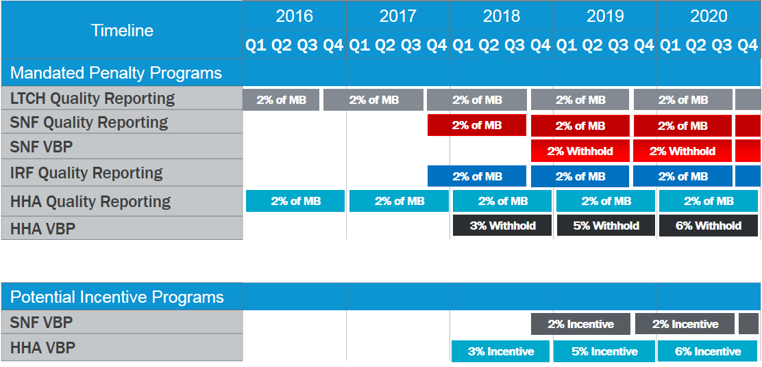
High Level Regulatory PAC Payment Impact
Notes:
LTCH = Long Term Care Hospital
SNF = Skilled Nursing Facility
IRF = Inpatient Rehabilitation Facility
HHA = Home Health Agency
VBP = Value Based Purchasing

Slide 16
Questions?

